Slide 1




Slide 2

CUBES

Slide 3
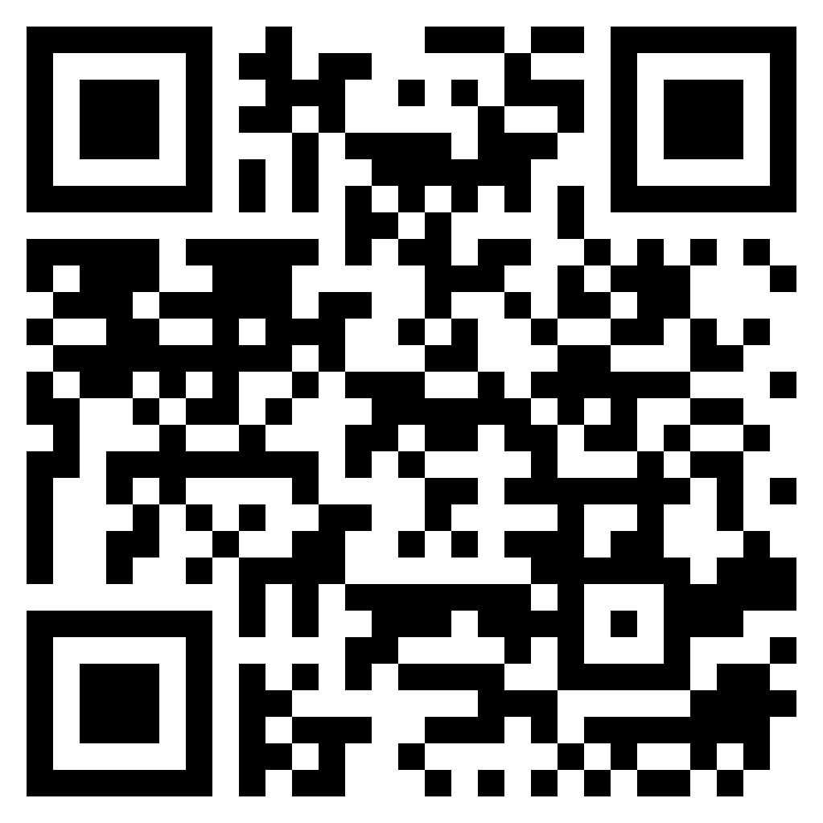
TEST TIME ON DIRECTIONS
URL: https://forms.gle/ksD6xk9ZDJoc2NM6A
QR CODE:

Slide 4
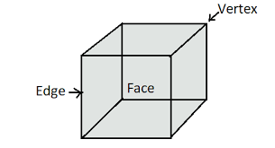
CUBES
A cube is a 3 dimensional diagram.
In a cube, there are 6 faces, 8 vertices & 12 edges.
First we need to know some of the basic terminology in cubes concept:
FACES - Also called facets or sides. A cube has six faces which are all squares, so each face has four equal sides and all four interior angles are right angles.
VERTEX - A point formed where three edges meet. A cube has 8 vertices.
EDGES - A line segment formed where two edges meet. A cube has 12 edges. Because all faces are squares and congruent to each other, all 12 edges are the same.

Slide 5
In cube since all the sides are equal , Length = Breadth = Height = a.
Volume of the cube is = a^3.
Total surface area of the cube is = 6a^2.
Diagonal of a cube is √3a.
Some of the types of questions you will be facing is
Cutting the cube
Coloring the cube

Slide 6
If we have to cut a cube to the maximum of 3 cuts how many pieces will we have?
1 dimensional cube of maximum of 3 cuts will give 4 pieces.
2 dimensional cube of maximum of 3 cuts will give 6 pieces , 2+1( cuts) -> 3 * 2 = 6 ( pieces)
3 dimensional cube of maximum of 3 cuts will give 8 pieces , 1+1+1( cuts) -> 2*2*2 = 8 (pieces)
While the distribution of the cuts it is always the close number of cuts possible in 3 dimensional should give maximum number of cuts.
While cutting a cube in 3 dimensional with maximum of 6 cuts we will get 27 pieces, 2+2+2 ( cuts) -> 3*3*3= 27 ( pieces).
Notes:
https://youtu.be/0TdF_yyNkZk please refer this link before going to class.

Slide 7
A cube is colored in three different colors in opposite sides, when the cube is cut in 9 pieces we should find the number of cubes :
In all 3 faces painted
In 2 faces painted
In 1 face painted
No face is painted
To find this we should know this,
Where , 9 faces painted will be 64 cuts.
The number of cubes in all 3 face painted, which is the corner cubes will be 8.
The number of cubes in 2 face painted , which is the edge center cubes will be 2 *12 = 24.
The number of cubes in only one face painted which is the face centered cube 4* 6 = 24.
The number of cubes in no face painted which will lie in the face centered middle layers will be 8.
Notes:
https://youtu.be/0TdF_yyNkZk please refer this link before going to class.

Slide 8
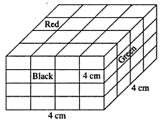
Question: Q01
A cube of each side 4 cm, has been painted black, red and green on pairs of opposite faces. It is then cut into small cubes of each side 1 cm.How many small cubes will have only two faces painted ?
18
20
22
24
Answer : D

Slide 9
Explanation
Each edge of the big cube 4 small cubes are connected and two out of them are situated at the corners of the big cube which have all the three faces painted. Thus, to each edge two small cubes are left which have two faces painted. As the total no. of edges in a cube are 12,
hence the no. of small cubes with two faces coloured= 12×2
12×2 = 24.
Notes:
D

Slide 10
Question: Q02
A cube of each side 4 cm, has been painted black, red and green on pairs of opposite faces. It is then cut into small cubes of each side 1 cm. How many small cubes will be only red painted ?
8
10
6
16
Answer : A

Slide 11
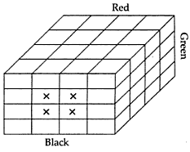
Explanation
No. of small cubes having only red paint
= 4 + 4 = 8
Notes:
D

Slide 12
Question: Q03
The following questions are based on the information given below:
All the faces of cubes are painted with red colour.
The cubes is cut into 64 equal small cubes.
How many small cubes have no faces coloured ?
24
16
8
0
Answer : C

Slide 13
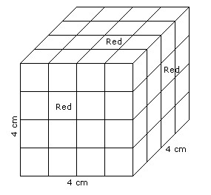
Explanation
There are 64 small cubes
One side of a big cube is 4 cm.
Number of small cubes having only one faces coloured = (x - 2)³
Here, x = side of big cube / side of small cube
x = 4 /1
x = 4
Required number = (4 -2)³
= 8
Notes:
D

Slide 14
Question: Q04
The following questions are based on the information given below:
All the faces of cubes are painted with red colour.
The cubes is cut into 64 equal small cubes.
How many small cubes are there whose two adjacent faces are coloured red ?
24
16
8
0
Answer : A

Slide 15
Explanation
There are 64 small cubes
One side of a big cube is 4 cm.
Number of small cubes having two adjacent faces coloured red = (x - 2) x No. of edges
= (4 - 2) x 12
= 24
Notes:
D

Slide 16
Question: Q05
A cube is cut in two equal parts along a plane parallel to one of its faces. One piece is then coloured red on the two larger faces and green on the remaining, while the other is coloured green on two smaller adjacent faces and red on the remaining. Each is then cut into 32 cubes of same size and mixed up. How many cubes have two red and one green face on each ?
0
8
16
4
Answer : D

Slide 17
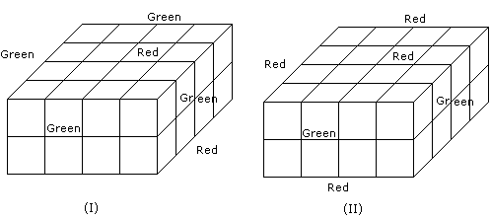
Explanation
From the second diagram we will have only 4 cubes with 2 red and 1 green face on each
Notes:
D

Slide 18
Question: Q06
If a cube is cut 17 times , then what is the maximum number of identical pieces that can be obtained ?
250
288
294
275
Answer : C

Slide 19
Explanation
Let’s make cuts parallel to the face planes of the cube. If we make a cuts parallel to 2 opposite faces, a+1 identical pieces might reveal themselves. Same with the other two pairs of opposite faces for a total of (a+1)(b+1)(c+1) pieces. So we maximize (a+1)(b+1)(c+1) subject to a+b+c=17. Perhaps, a=5,b=6 and c=6, making 294 pieces.
Notes:
D

Slide 20
Question: Q07
What is the maximum number of identical pieces a cube can be cut into by 13 cuts?
120
150
140
160
Answer : B

Slide 21
Explanation
First cut will divide the cube in 2 parts. The second cut along perpendicular direction will double the number of parts to 4, now the 3rd cut will also be in perpendicular direction which will double the 4 parts to 8. So totally 8 cubes can be formed with 3 cuts. All the 3 direction should be perpendicular to each other.Note that 1 cut = 2 parts of cube, 2 cut = 3 parts and so on. x cuts made along one plane results in x + 1 pieces. Logic behind this is, divide the given number of cuts in 3 equal parts and put that many cuts on each perpendicular direction.
For obtaining identical pieces, cuts must be made parallel to 3 planes of the cube.
Let we made x, y, z cuts along all three planes such that (x+1)(y+1)(z+1) = t is maximum & x + y + z = 13.
Different combinations can be possible but t will be maximum in (4, 4, 5) cuts.
So maximum pieces = (4 + 1) * (4 + 1) * (5 + 1) = 5 * 5 * 6 = 150
Notes:
D

Slide 22

Question: Q08
Six dice with upper faces erased are as shows.
The sum of the numbers of dots on the opposite face is 7.If even numbered dice have even number of dots on their top faces, then what would be the total number of dots on the top faces of their dice?
12
14
18
24
Answer : C

Slide 23
Explanation
Even numbered dice are: (II), (IV) and (VI)
No. of dots on the top face of (II) dice = 6
No. of dots on the top face of (IV) dice = 6
and No. of dots on the top face of (VI) dice = 6
Therefore Required total = 6 + 6 + 6 = 18
Notes:
D

Slide 24
Question: Q09
Six dice with upper faces erased are as shows.
The sum of the numbers of dots on the opposite face is 7.If even numbered dice have even number of dots on their top faces, then How many small cubes have three faces coloured ?
8
18
12
24
Answer : A

Slide 25
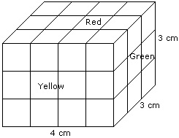
Explanation
Such cubes are related to the corners of the cuboid and there are 8 corners.
Hence, the required number is 8.
Notes:
D

Slide 26
Question: Q10
A cube is painted with red. It is divided into 512 small cubes. How many sides are painted?
144
384
286
260
Answer : B

Slide 27
Explanation
Divided into 512 equally big cubes, right? OK. So 8 x 8 x 8. That means we have 8 x 8 = 64 minicube-sides painted on each face of the original cube that has 6 faces. So, 6 x 64 = 384 painted sides
Notes:
D

Slide 28
Question: Q11
A cube is painted blue on all faces and it is cut into 64 small cubes of equal size. How many cubes are not painted?
6
4
8
2
Answer : C

Slide 29
Explanation
Let this be the original cube .
It is cut into 64 small cubes ( demarcated by lines ) .
Let's go layer wise ( top to bottom )
There are 4 layers .
1st layer :-
All the cubes are painted . No. Of unpainted cubes = 0
2nd layer :-
Only side cubes are painted , internal 4 cubes ( middle most ) are not painted .
No. Of unpainted cubes = 4
3rd layer:-
Same as layer 2 , No. Of unpainted cubes= 4
4th layer:-
Same as layer 1 . No unpainted cubes.Total unpainted cubes= 8
Notes:
D

Slide 30
Question: Q12
64 small cubes joined to form a single large cube. The outer surface of the cube is painted by red color. How many of the smaller cubes will not have a colored face?
14
12
10
8
Answer : D

Slide 31
Explanation
For cube we will use formula
L×b×h=4×4×4=64
Cubes painted on 3 sides=8
2 sides=2×12=24
1 side =4×6=24
Then sum of all three=8+24+24=56
It means that the cube with no colored face will be=64–56=8
Notes:
D

Slide 32
Question: Q13
If a cube is formed with 64 smaller cubes, how many cubes of the cube formed are hidden?
4
6
8
10
Answer : C

Slide 33
Explanation
In a cube consisting of 64 smaller cubes, the arrangement of the smaller cubes is 4 X 4 X 4 . The outer layer of small cubes on all sides is what is seen. Since these outer layers are the thickness of one small cube, it’s pretty easy to visualize that, in each 4 X dimension, the single cubes on the ends are what are visible, and the 2 smaller cubes in the middle aren’t. Therefore, hidden within is a 2 X 2 X 2 cube which obviously contains 8 smaller cubes.
Notes:
D

Slide 34
Question: Q14
A 7 x 7 x 7 cube is painted then cut into 1 x 1 x 1 cubes. How many of the cubes is painted on exactly 2 sides?
60
120
40
80
Answer : A

Slide 35
Explanation
Only the edges of the cube can be painted only on 2 sides, because egde pieces have 2 sides. The edges are the pieces located between any 2 corners of the cube, vertical and horizontal, even if its 3x3x3. In this case the cube is 7x7x7, which means that it has 12 big edges. Each edge is made of 5 small edges (pieces). And if you sum this up you will get the total number of edges.
5(pieces) x 12(edges) = 60(pieces)
Notes:
D

Slide 36
Question: Q15
A cube of edge 3 cm is painted black from all its faces. It is now cut into 1 cm cubes. How many of these shall be painted on two faces?
12
14
16
18
Answer : A

Slide 37
Explanation
On cutting the cube (3×3×3), 27 cubes (1×1×1) will be formed.
We can exclude the eight cubes at the corners, as three faces are painted.
We can also exclude the one central cube, as it's faces are not painted.
The middle cubes of each face can be excluded, as only one face is painted. That counts to six cubes.
The rest of the cubes (1×1×1) will be painted on two faces.
27 - (8+1+6) = 12
Notes:
D

Slide 38
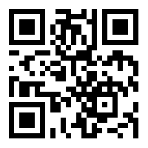
https://learn.codemithra.com

Slide 39
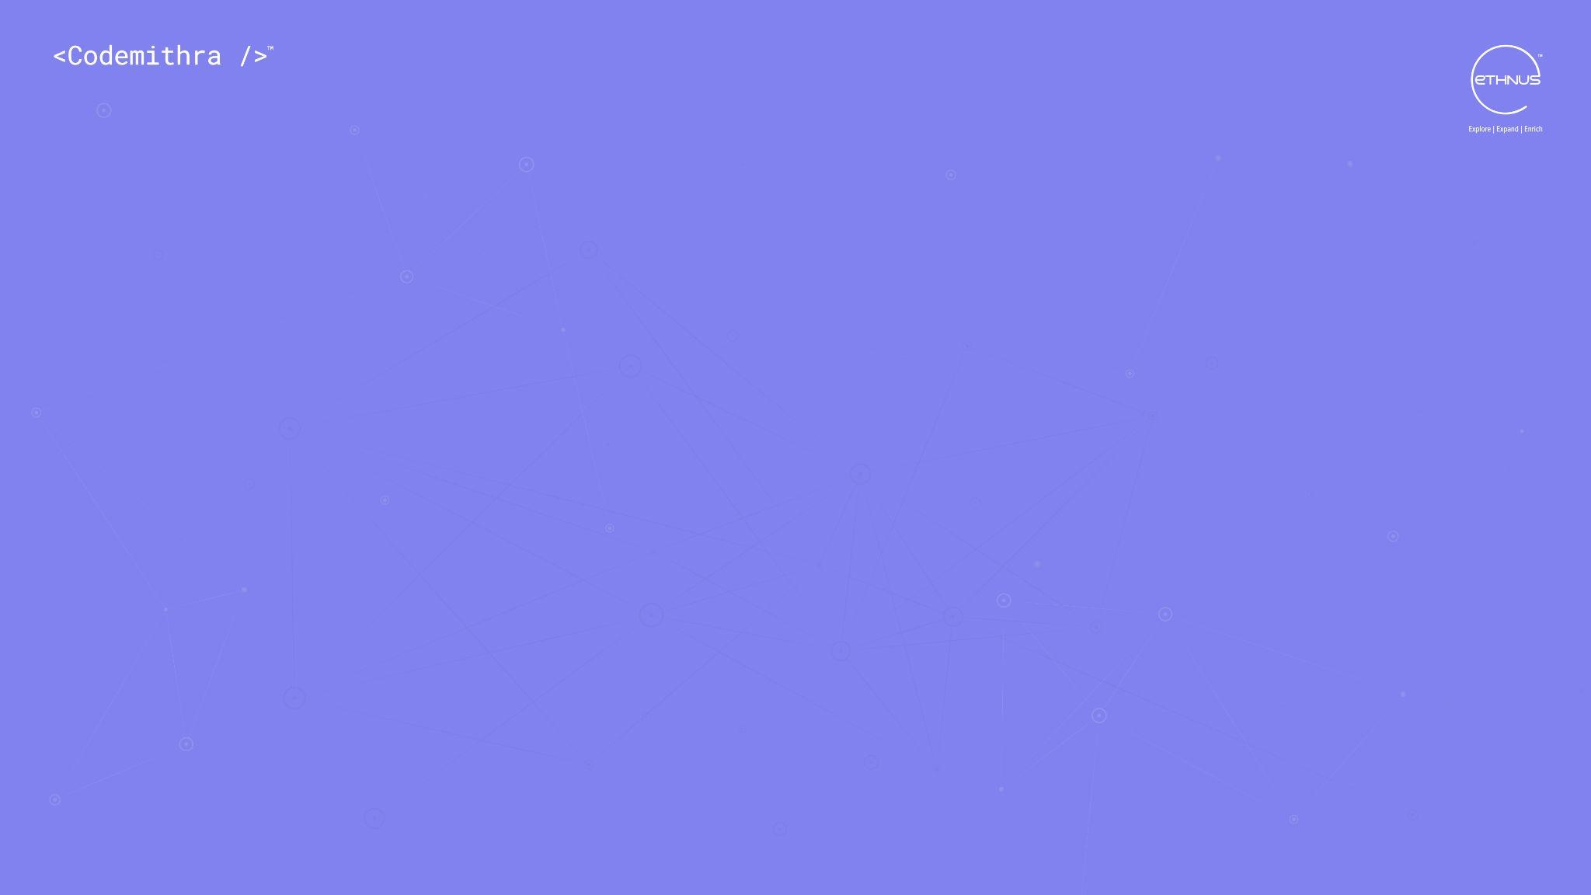



THANK YOU
+91 78150 95095
codemithra@ethnus.com
www.codemithra.com

